Slide 1
Competition between Model-based and Model-free Learning
——Arbitration model
张博涛 进展汇报

Slide 2
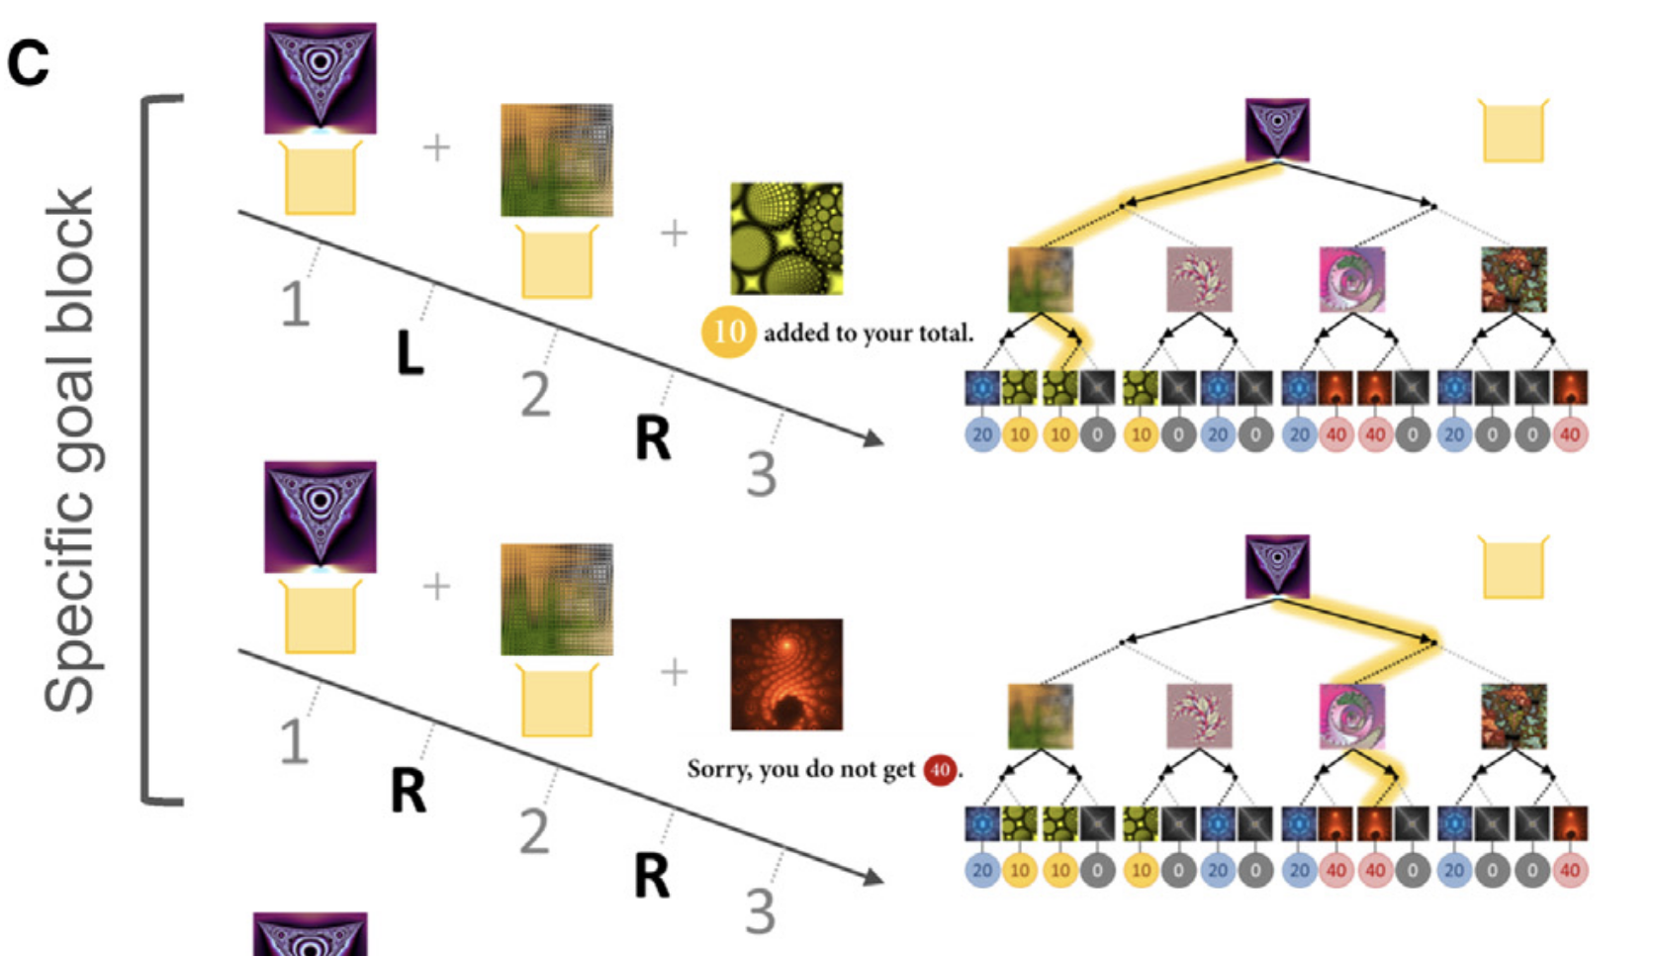
Task setting: Two Stage Task

Slide 3
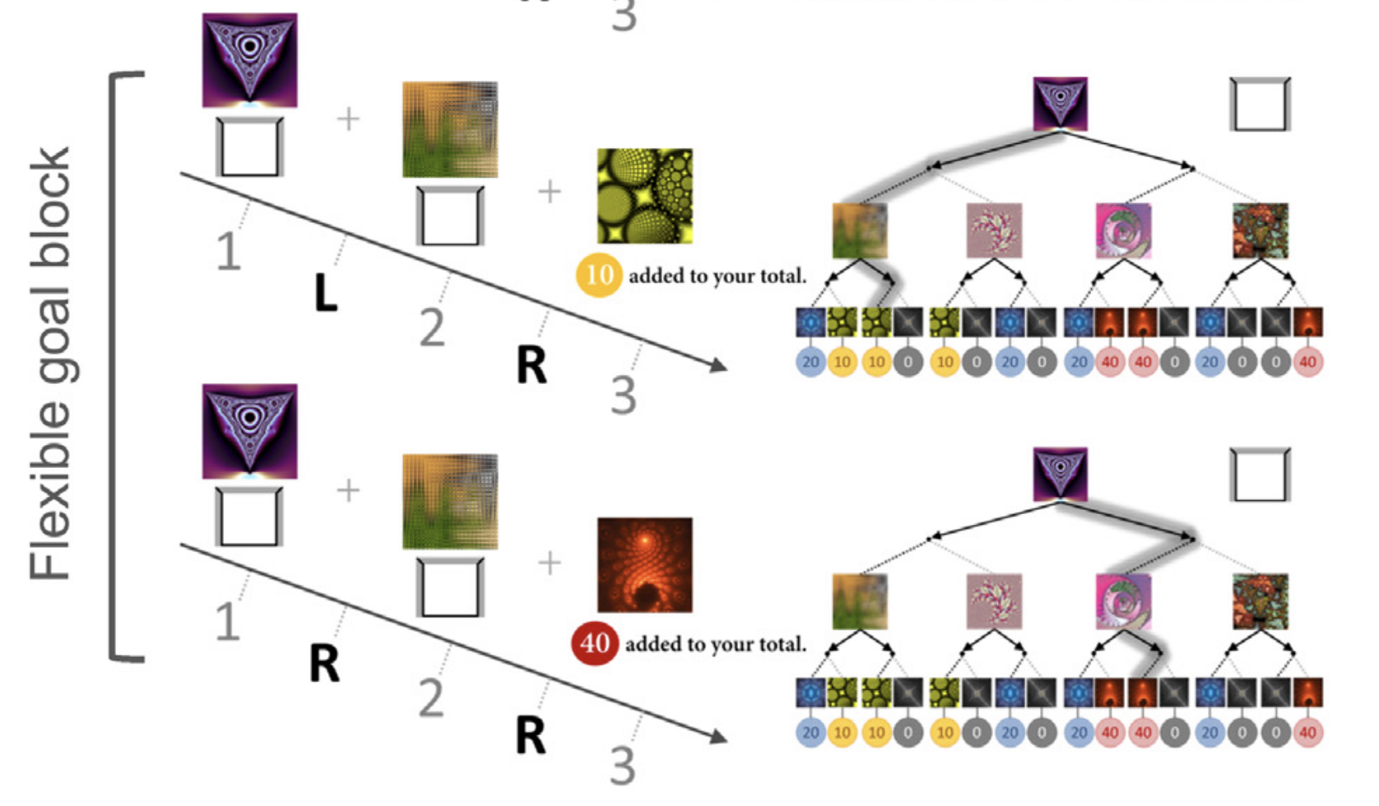
Task setting: Two Stage Task

Slide 4
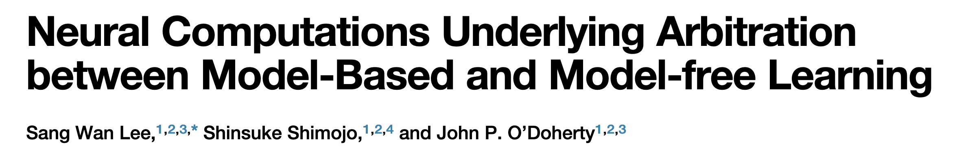
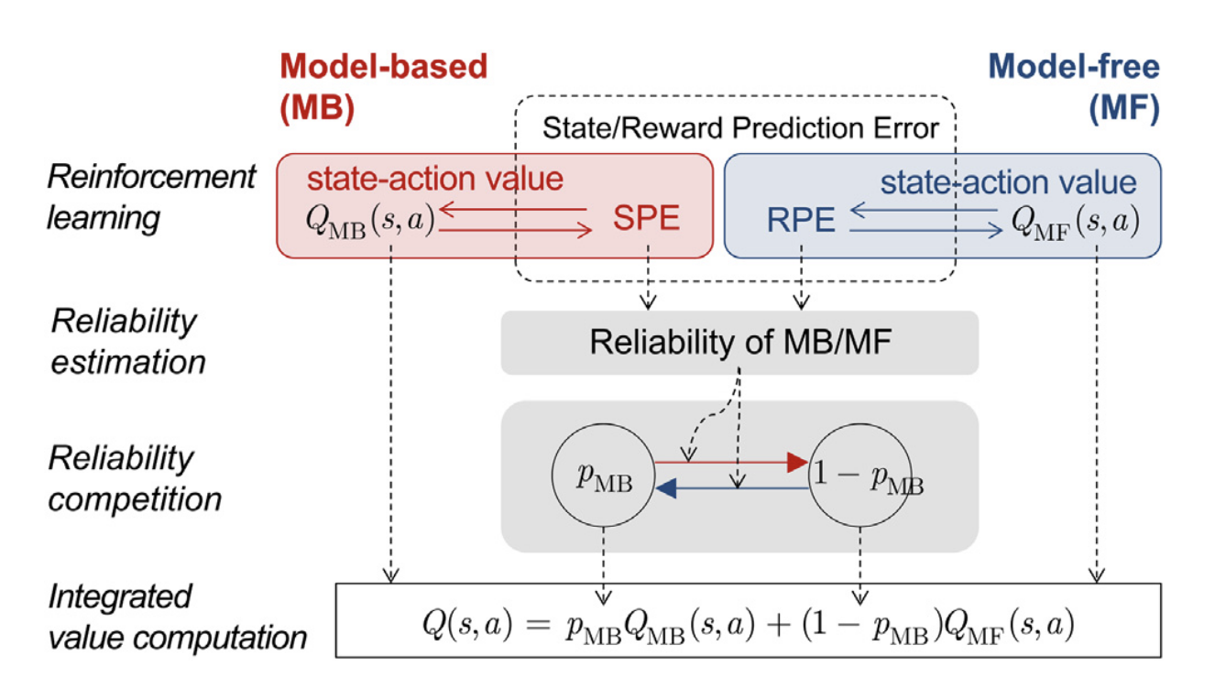

Slide 5
based on ten past trials’ prediction errors. model with Dirichlet distribution
velocity
Telegraph process

Slide 6
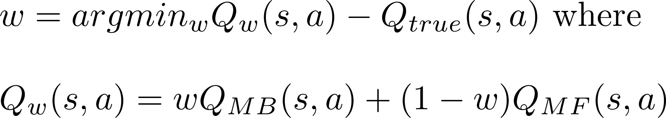
Loss4arbitration Model

Slide 7
Loss4arbitration Model

Slide 8
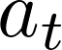
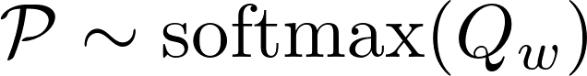
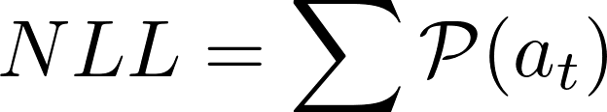
Model Fitting
minimize negative loglikelihood
subjects’ data: true actions,
model’s prediction:
negative loglikelihood:

Slide 9
Model Fitting
150 trials.
trial 1 ~ 37: fixed goal(20), low uncertainty(0.9,0.1)
trial 38 ~ 75: flexible goal, low uncertainty
trial 76 ~ 112: fixed goal(10), high uncertainty(0.5)
trial 113 ~ 150: flexible goal, high uncertainty(0.5)
back planning(MB)

Slide 10
Model Comparison
MB: pure model-based learning
MF: pure model-free learning
Hybrid: , but fixed w
Loss4arbitration:
1. larbi: MF learning rates * 2, MB ... * 2, discount, w’s learning rate, exploration temperature * 2
2. larbi_mini: MF, MB, w learning rates, exploration temperature * 1
3. larbi_star: based on mini, but MB learning rate = MF’s
4. larbi_2: based on mine, but a separate arbitration w at each stage

Slide 11
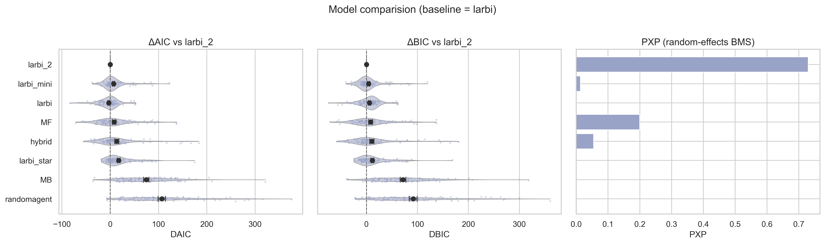
Model Comparison

Slide 12
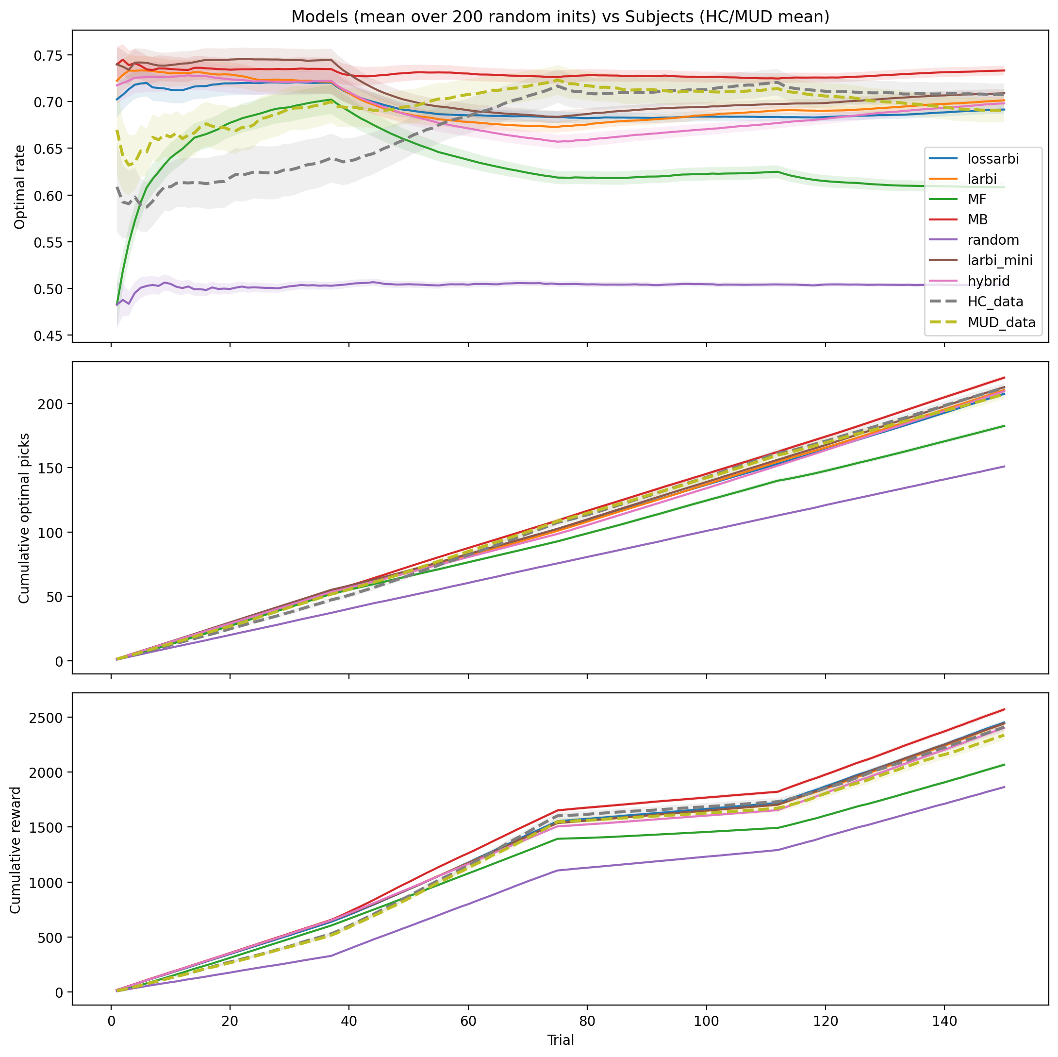
Model Comparison

Slide 13
Model Comparison

Slide 14
Model Comparison

Slide 15
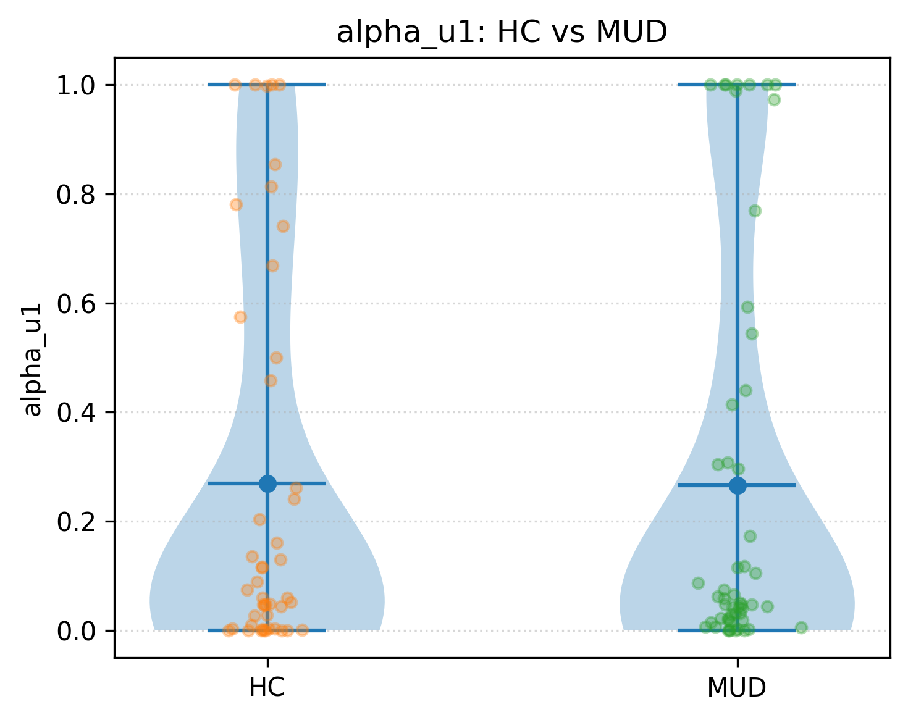
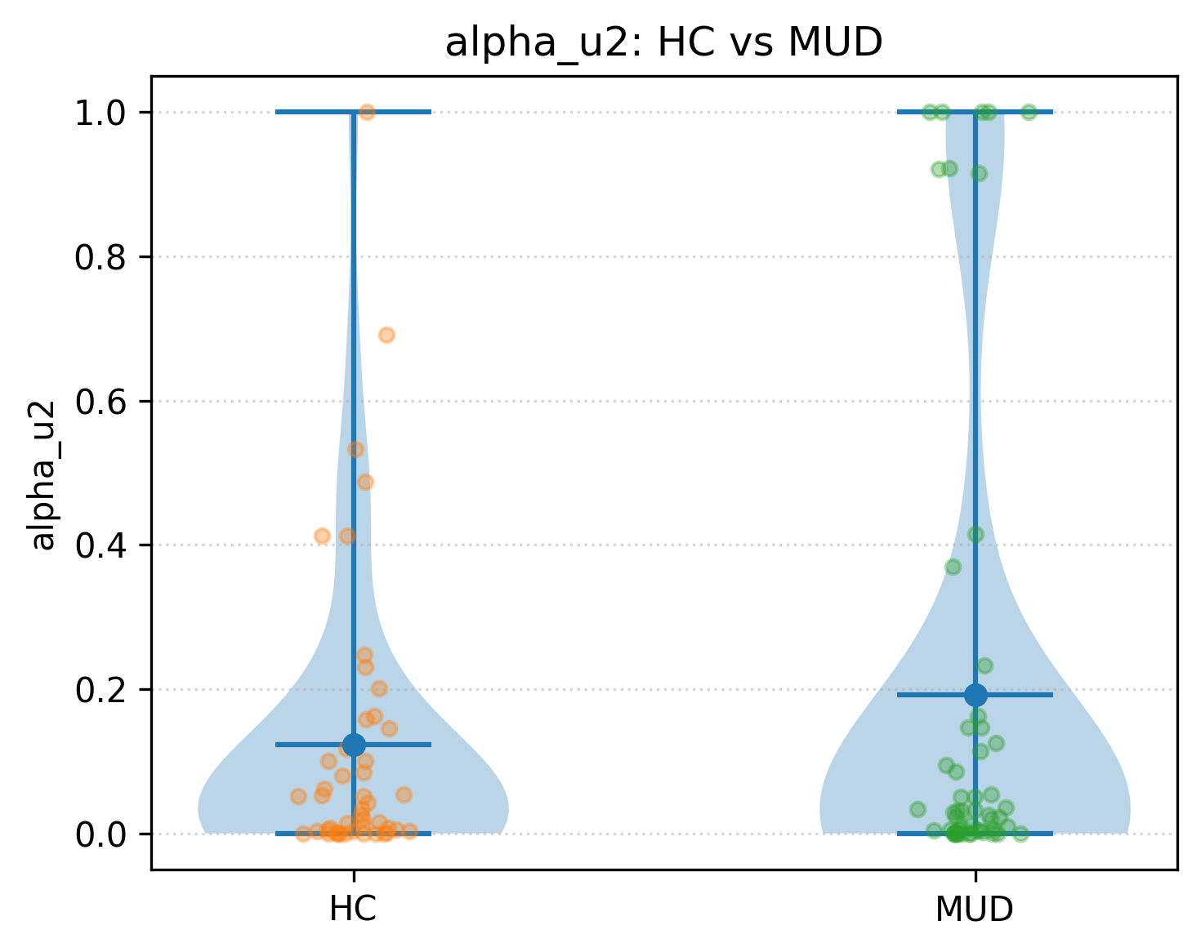
Results Analysis

Slide 16
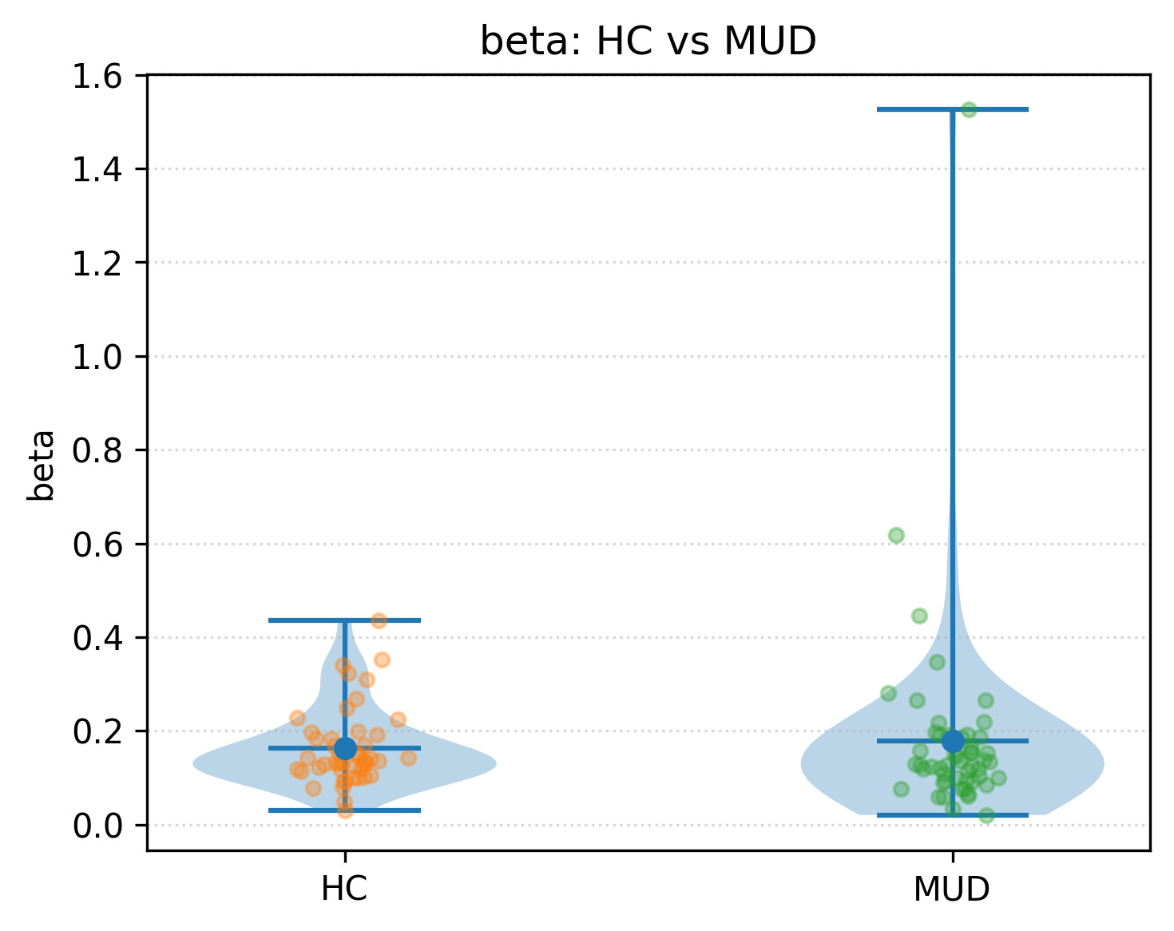
Results Analysis

Slide 17
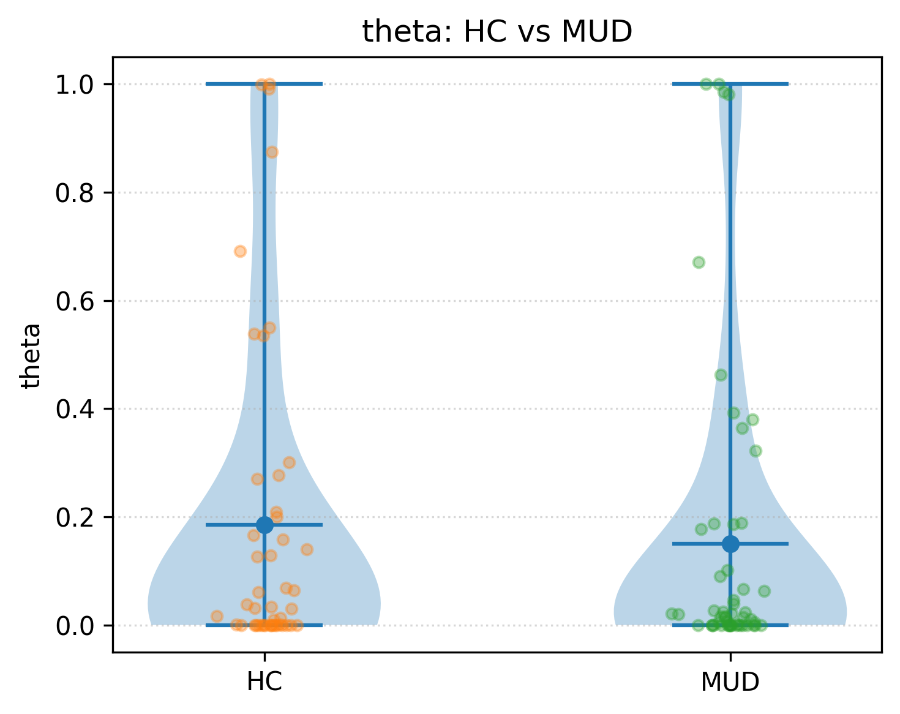
Results Analysis
around 1/3 is 0

Slide 18
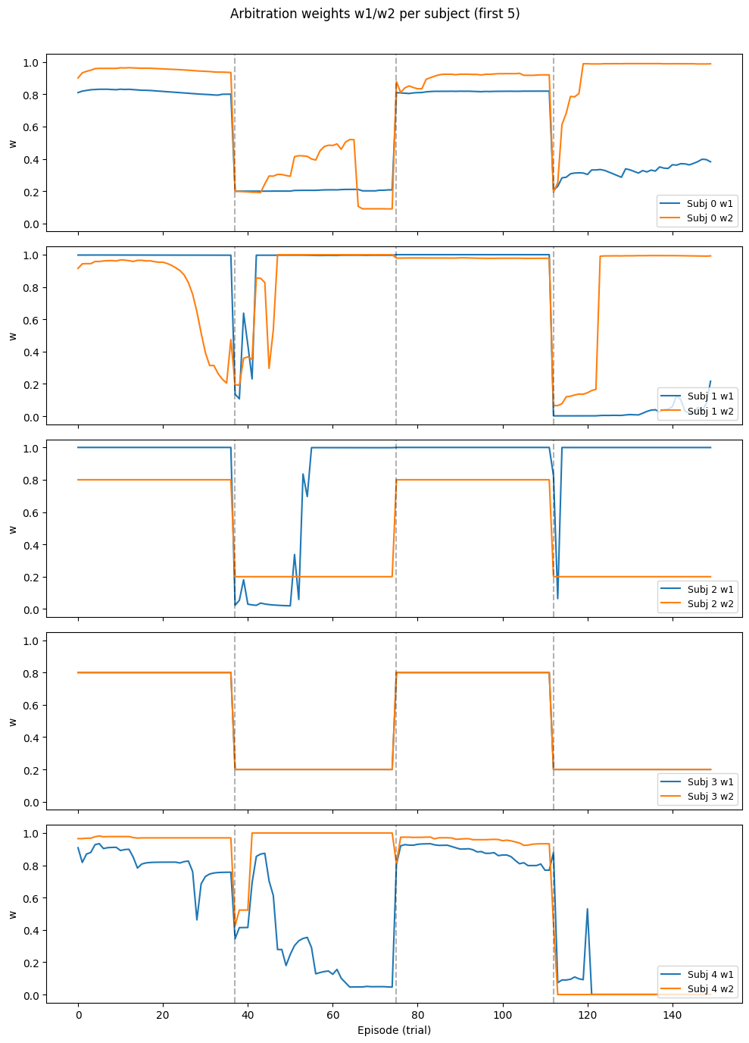
Results Analysis

Slide 19
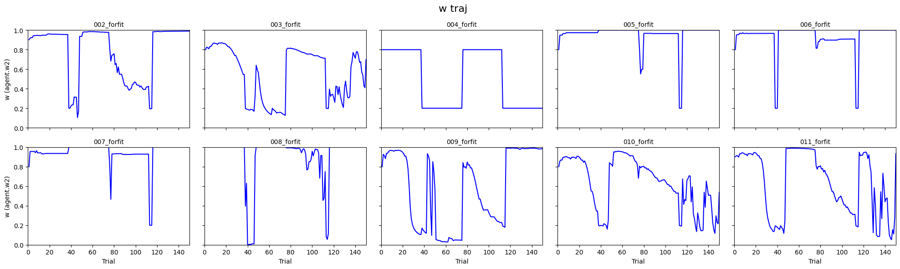
Results Analysis

Slide 20
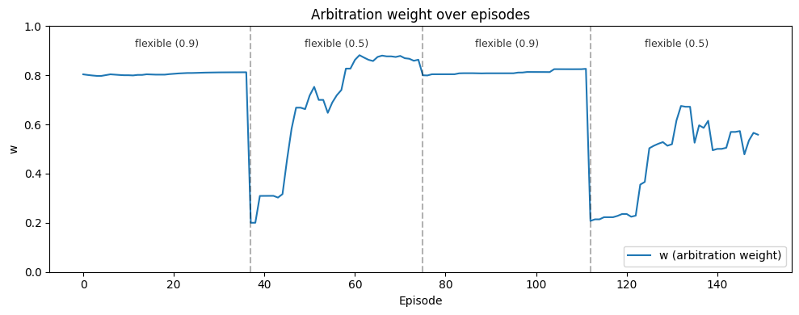
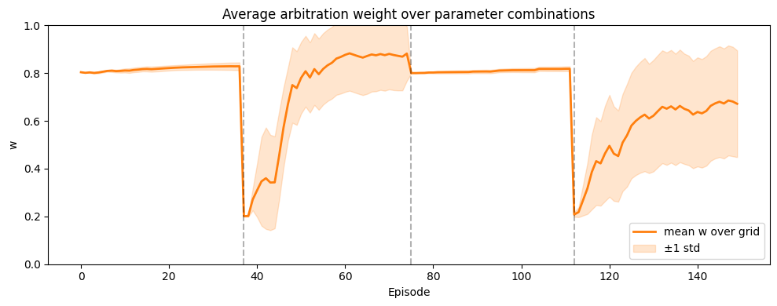

Slide 21
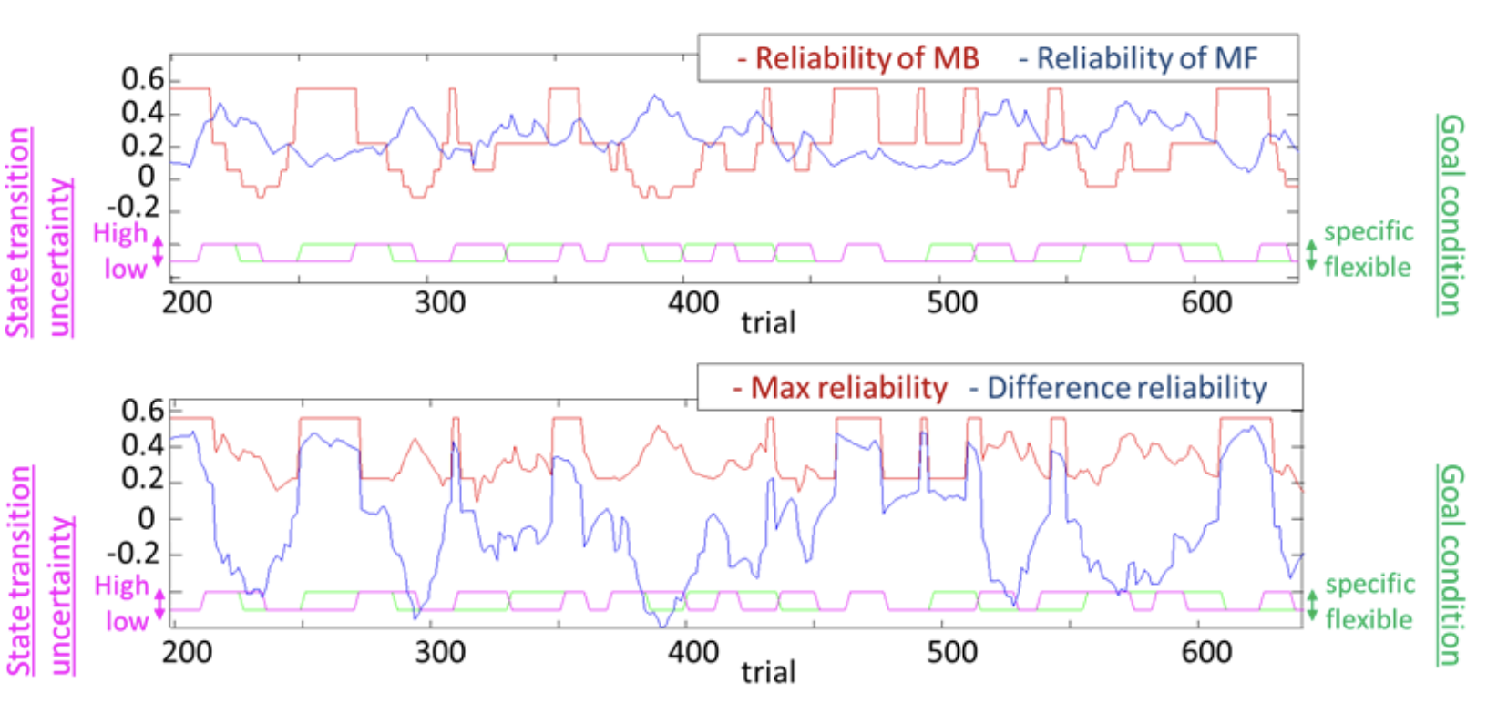
Possible Explanations

Slide 22
Possible Explanations
However, to incentivize subjects to continue learning, throughout the task, the chances of payoff associated with the four second-stage options were changed slowly and independently, according to Gaussian random walks.
In the Lee 2014 task setting, perhaps Model-Based is oftentimes better?
(also, from the total reward attained at each block)

Slide 23
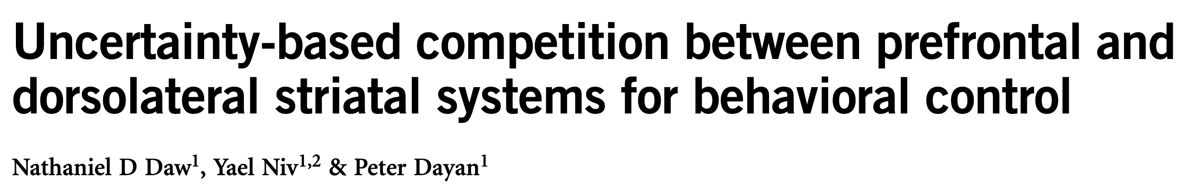
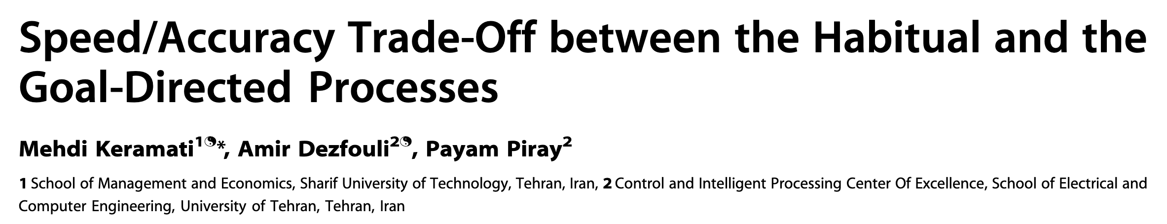
The current state of research on MB-MF competition/cooperation

Slide 24
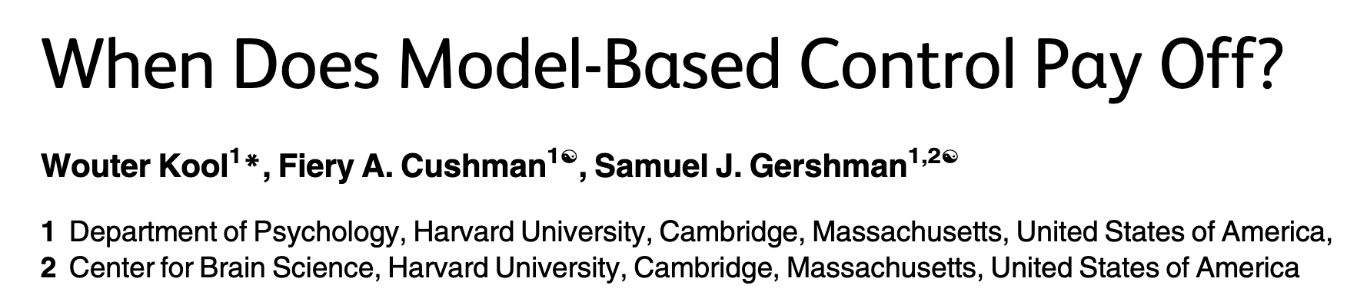
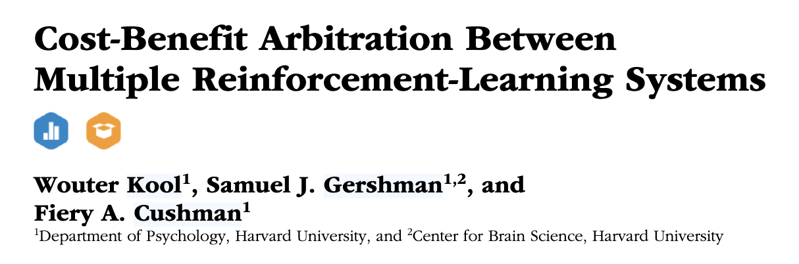
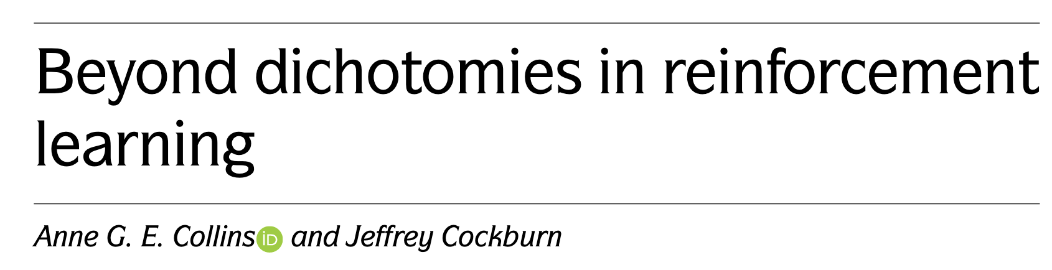

Slide 25
MB-MF competition/cooperation

Slide 26
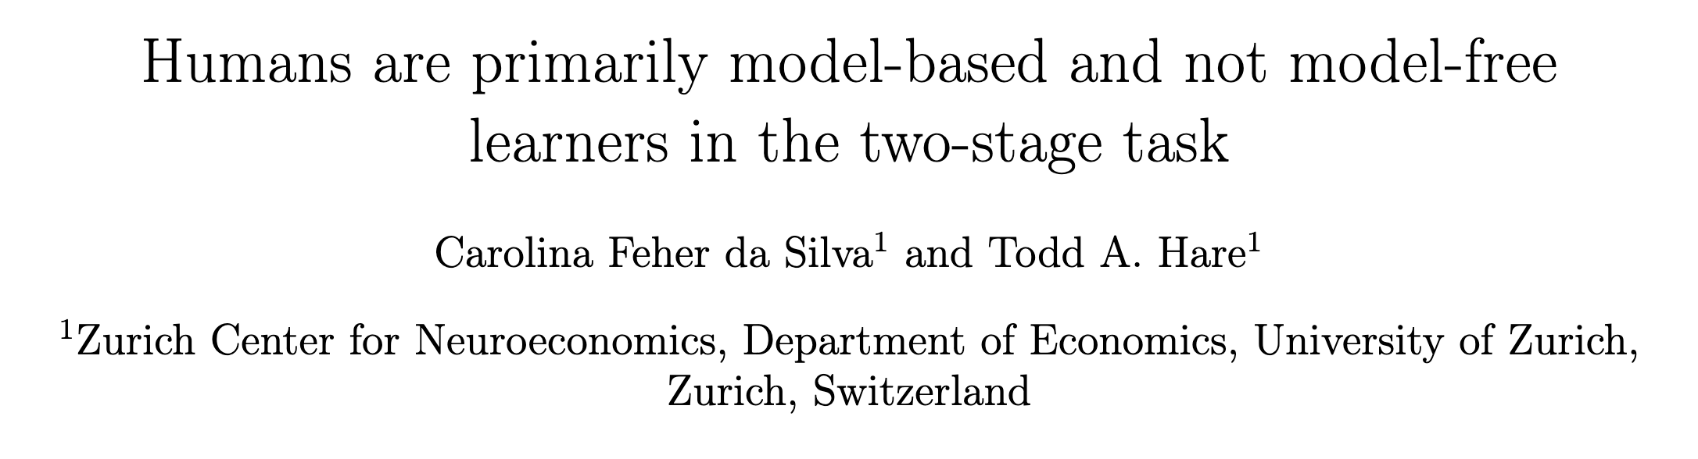
Two Stage Task

Slide 27
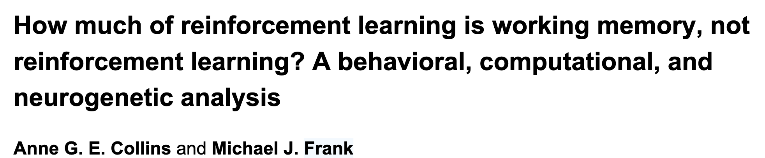
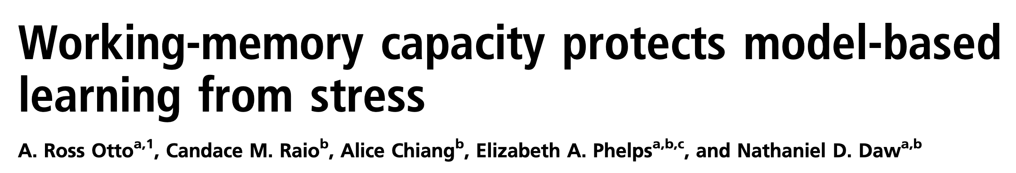
(In) Relation to Memory
“systematically varying the size of the learning problem and delay between stimulus repetitions”

Slide 28
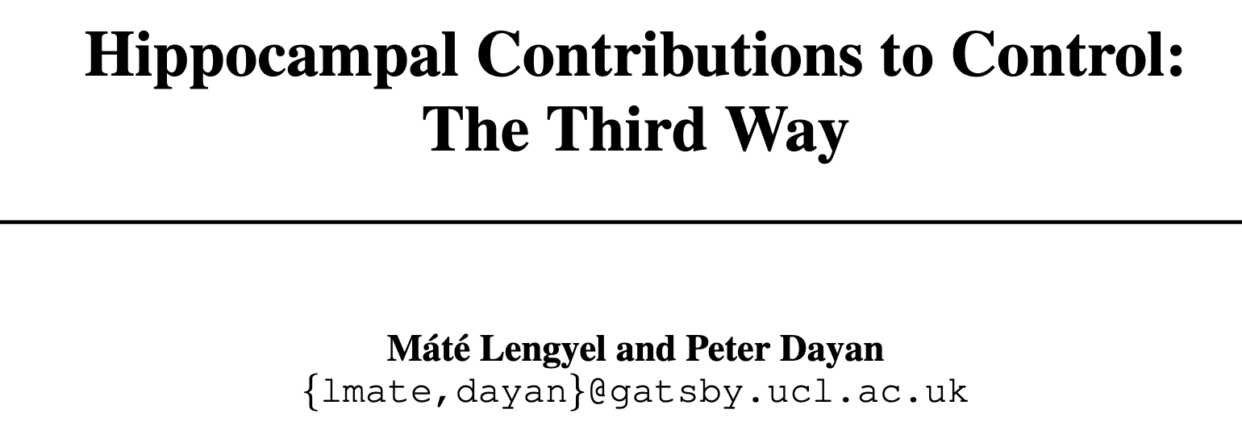
(In) Relation to Memory

